Slide 1
CSE 6207 · PROGRESS PRESENTATION
A Lightweight Recovery Pipeline
for Corruption-Resilient Medical Image Diagnosis under Constrained Hardware
Fahim Sadik Rashad | ID: 1024052019
BUET · Department of Computer Science & Engineering

Slide 2
01 · PROBLEM & APPROACH
What We're Solving
Medical classifiers are trained on clean images — but real X-rays carry noise, blur, and compression artifacts. These cause a silent accuracy collapse at deployment.
Our Approach
Why It Matters Here
A small recovery module sits in front of a frozen classifier, cleaning corrupted input at inference time — no retraining of the classifier.
Heavy recovery methods (diffusion editors) restore images but are too costly for constrained hardware. We ask: how light can recovery be and still work?
Perceptual loss: the recovery module is trained not to match pixels, but so the frozen classifier reads the cleaned image correctly — the classifier's own loss guides the cleaning.

Slide 3
02 · PROGRESS
What Is Built and Running
1
Fault Injection
Official MedMNIST-C corruption registry wired in — 13 corruption types × 5 severities, reproducible.
2
Baseline Classifier
MobileNetV2 trained on clean PneumoniaMNIST (64×64). Frozen for all later experiments.
3
Augmentation Baseline
Same model retrained with corruption augmentation — the bar to compare against.
4
Recovery Module
A family of lightweight autoencoders, trained with a classifier-perceptual loss.
5
Full Evaluation
Coverage across single / compound / unseen corruptions + real-world transfer test.
Status: full pipeline executed end-to-end with real results (next slides).

Slide 4
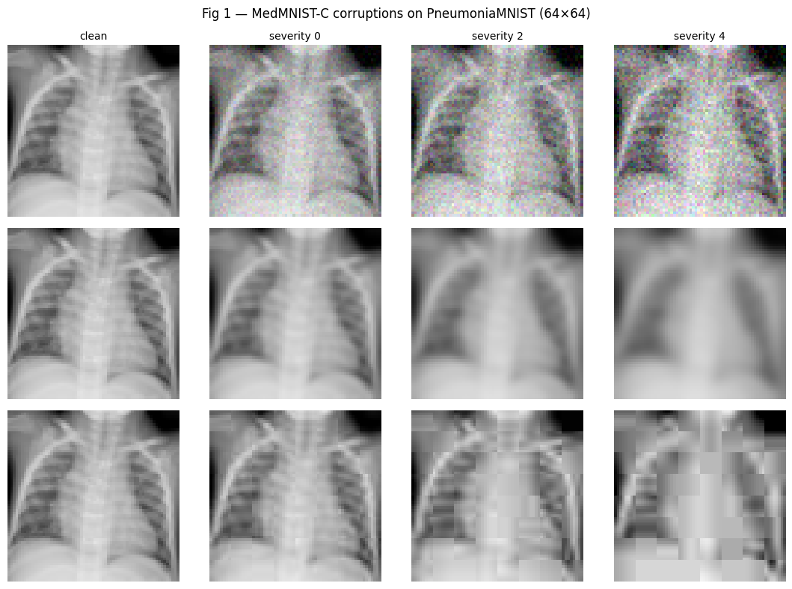
03 · THE FAULTS WE INJECT
What Corruption Looks Like
Real PneumoniaMNIST chest X-rays under the official MedMNIST-C corruptions. Top to bottom: noise, blur, JPEG compression — left to right: increasing severity.

Slide 5
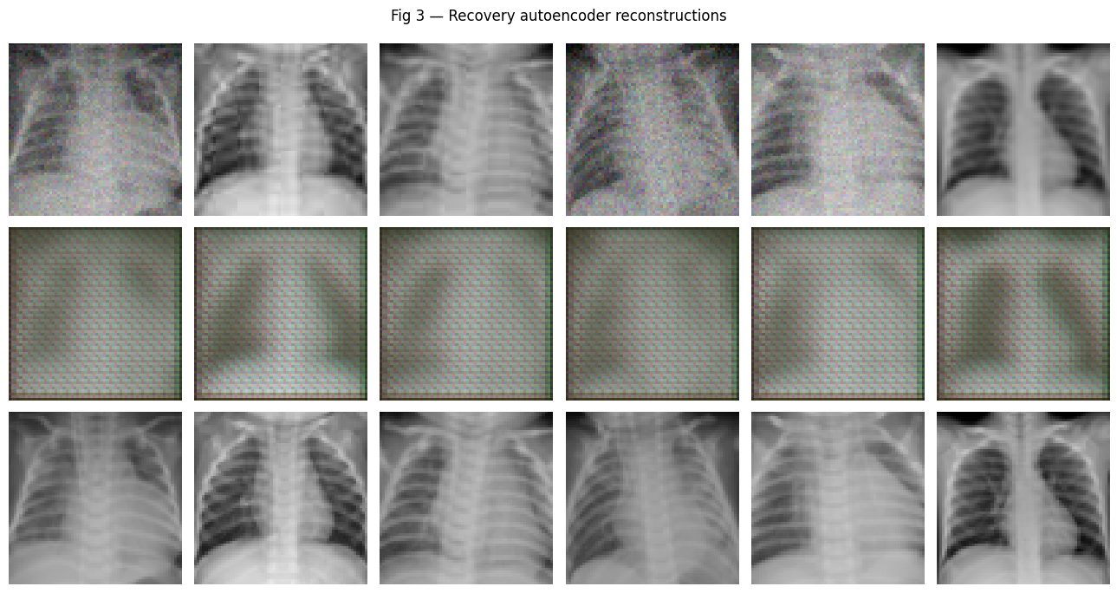
04 · WHAT THE MODULE PRODUCES
Corrupted → Recovered → Clean
Top: corrupted input. Middle: recovery-module output. Bottom: clean target. Note the recovered images aren't pixel-perfect — the module restores what the classifier needs, not human-faithful detail.

Slide 6
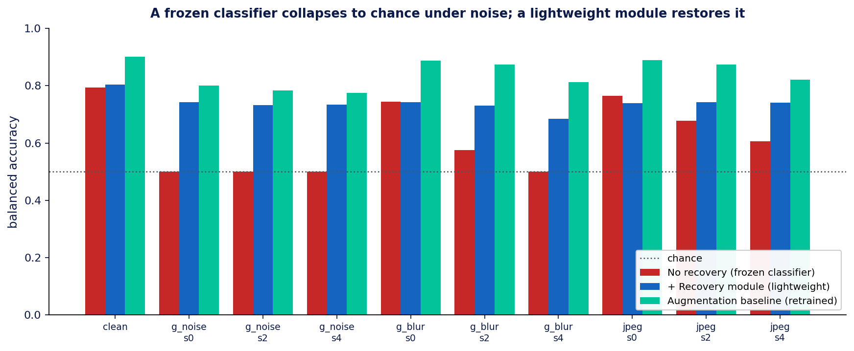
05 · KEY RESULT
The Collapse — and the Recovery
0.79 → 0.50
clean → noise
(chance)
+0.24
recovered by a
lightweight
module
Balanced accuracy used —
raw accuracy hides the collapse.
A frozen classifier falls to chance under noise; a small recovery module restores most of the lost accuracy without touching the classifier.

Slide 7
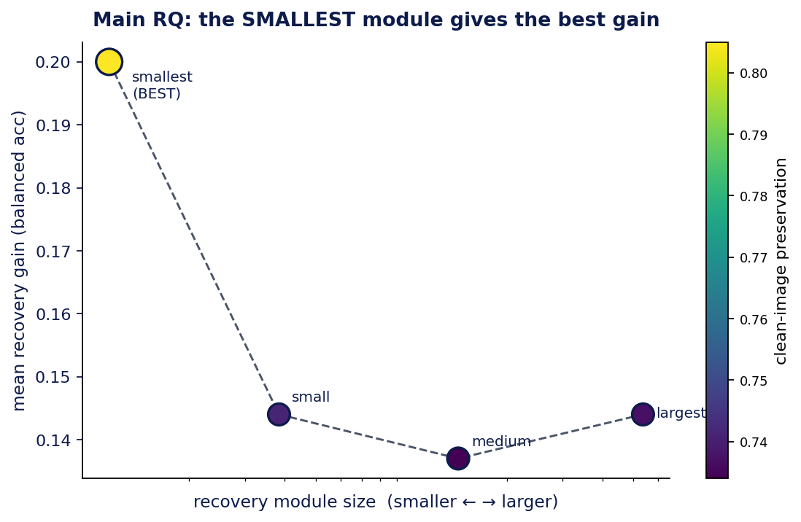
06 · MAIN RESEARCH QUESTION
How Light Can Recovery Be?
The Finding
The smallest module wins. The most compact module gives the best recovery gain — larger versions do not help more. Recovery adds negligible inference cost. This directly answers the Main RQ — lightweight recovery is not just feasible, it is optimal here.

Slide 8
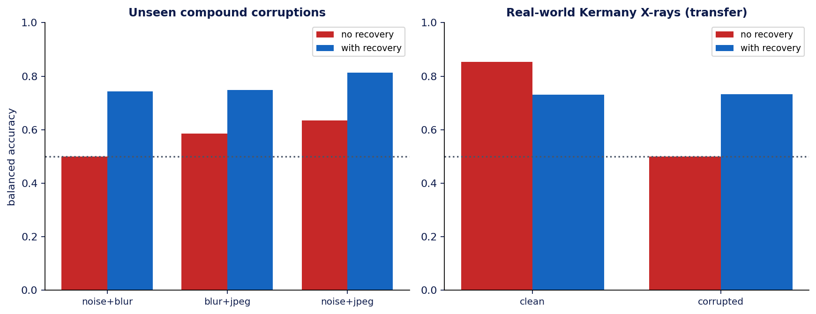
07 · SUB-QUESTIONS
Does It Generalize?
Sub-Q1 — Compound corruptions (never trained on): recovery holds (+0.16 to +0.24). Sub-Q2 — Real Kermany X-rays: transfer gain +0.232, identical to in-domain.

Slide 9
08 · FINDINGS & DIRECTION
What We Learned — and Where Next
Key Findings
Next Direction
Learned recovery ≫ classical denoiser
the autoencoder clearly beats a fixed filter.
Perceptual loss is essential
plain MSE training fails (learns identity).
Recovery is classifier-coupled
a module tuned to one classifier doesn't transfer to another.
Tested on pneumonia only
single modality (chest X-ray) so far — other modalities next.
Position against heavy diffusion recovery
frame the lightweight module against costly generative recovery methods.
Classifier-agnostic recovery
feature-space loss to fix the coupling limitation.
Other lightweight recovery modules
test efficient denoisers (DnCNN, NAFNet, HINet) in place of the autoencoder.
Other imaging modalities
extend beyond chest X-ray to dermatology, retinal, and histology images.

Slide 10
Summary
A lightweight module recovers a frozen medical classifier
from chance to ~0.74 — and the smallest model wins.
Validated on single, compound, and unseen corruptions, and on real-world Kermany X-rays.
Thank you · Questions?
Fahim Sadik Rashad · 1024052019 · CSE 6207

